Slide 1

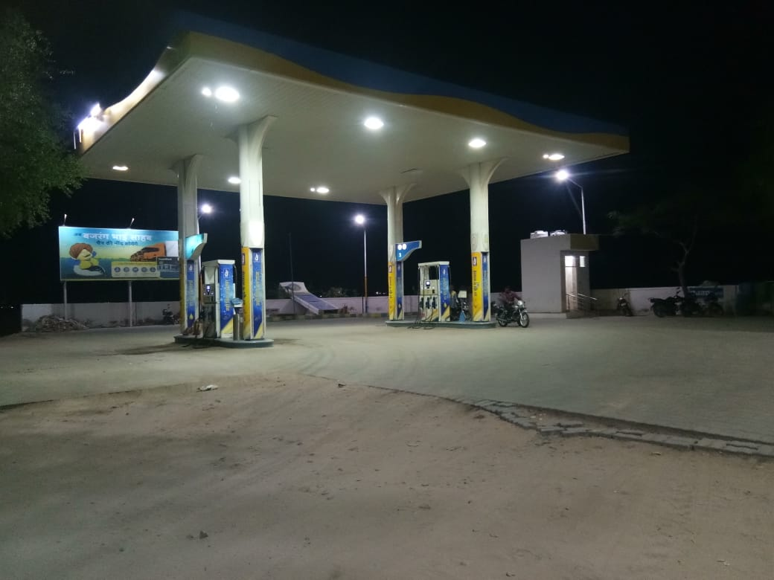
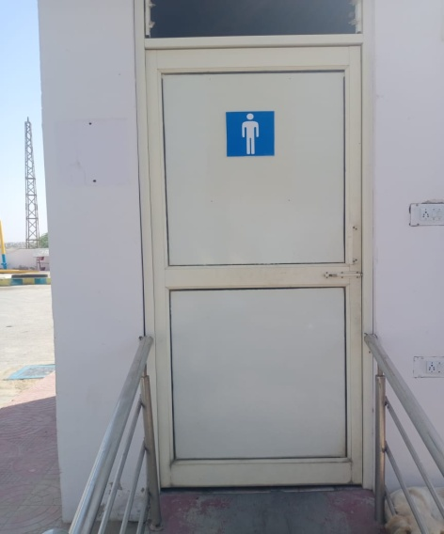
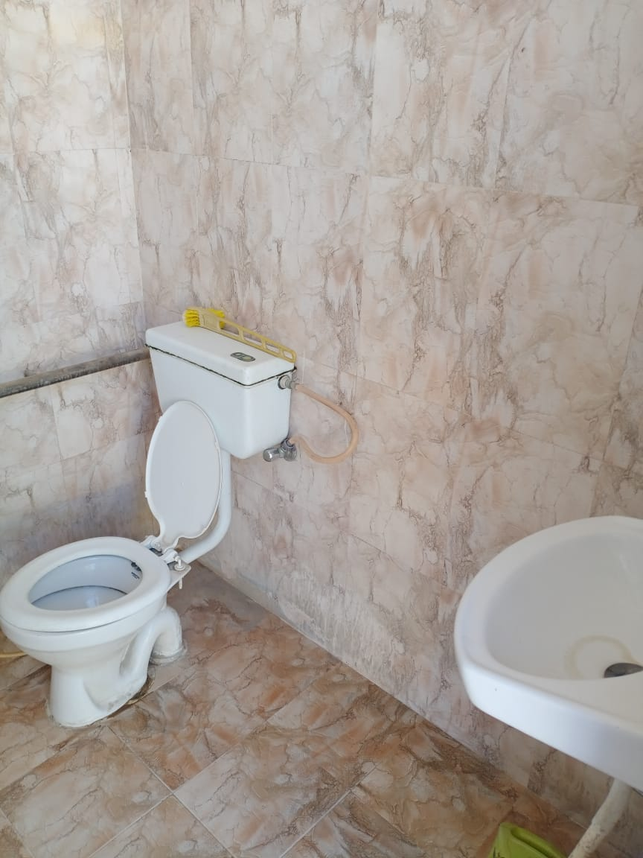
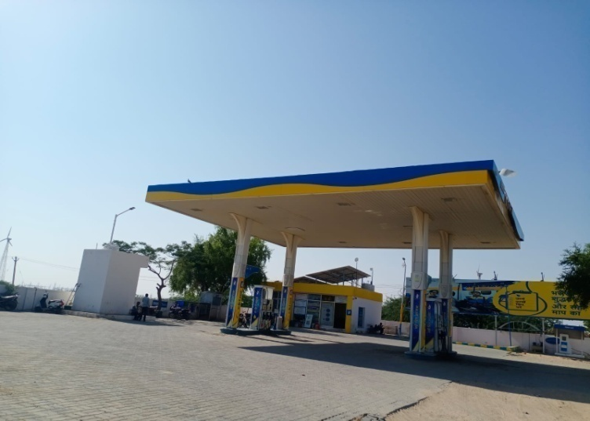
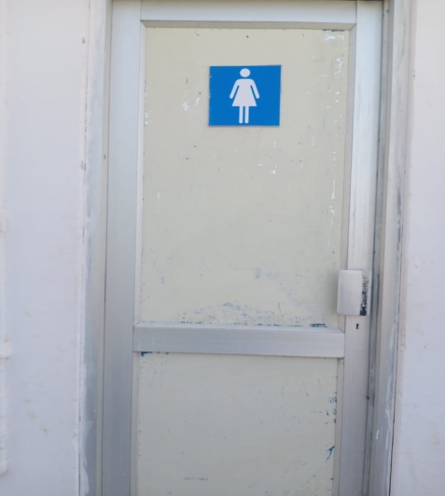
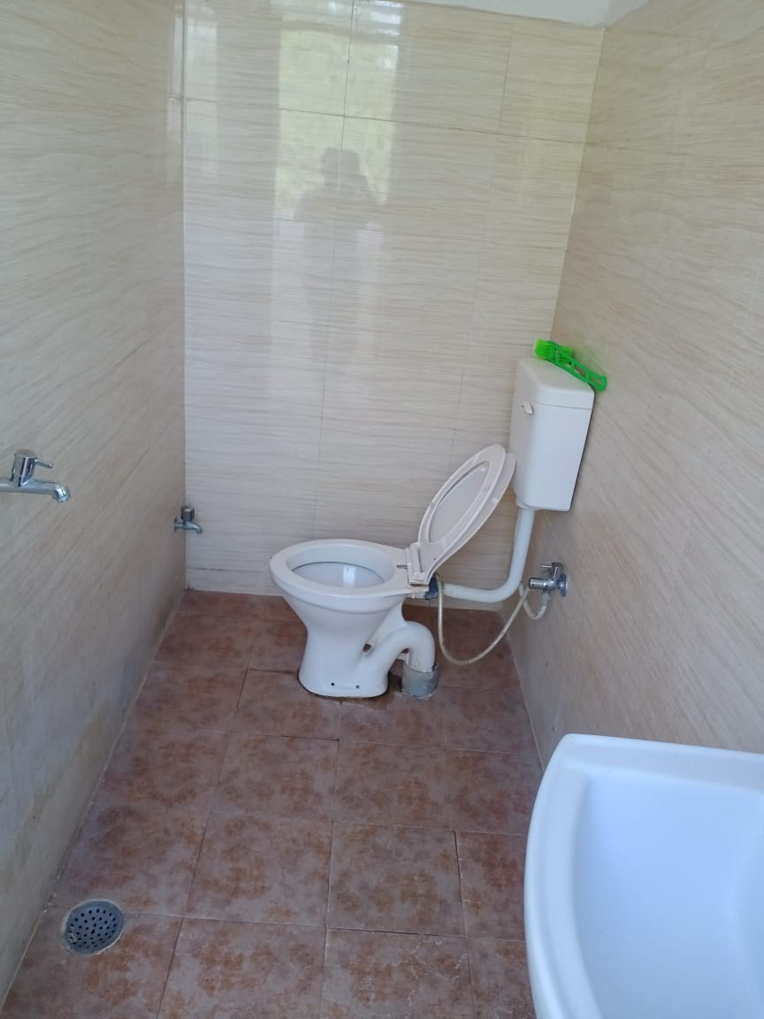
Bharat Petroleum -
Name of the Outlet : AKASH FUEL CNTRE Lat : 26.9452 Long : 70.8895
customer No.: 145213 Location : BADABAGH District : JSLMR State : Rajasthan

